Slide 1
Lab04 Packet Sniffing and Analysis
Prepared By Professor Sean He

Slide 2
1. Clone a new Client Machine (we named it as Sean-Client) follow this video
https://video.nottingham.edu.cn/Panopto/Pages/Viewer.aspx?id=84d40490-bbf2-4c1d-a100-afc2007c7ef7&start=0
2. Next, you need to configure the virtual machines by following the steps described in one the following videoclips, depending on whether you are using Oracle VM VirtualBox V6 or V7:
V6 - https://video.nottingham.edu.cn/Panopto/Pages/Viewer.aspx?id=19d691b1-c30f-4d7c-8993-afc2007de859&start=0
V7 - https://video.nottingham.edu.cn/Panopto/Pages/Viewer.aspx?id=2b83a6a0-e8d8-45d5-b06f-afc2007f3344&start=0
3. ***Refresh the MAC address, then use “sudo ifconfig” to check the address.
(make sure the address of the server machine and two client machines are different)

Slide 3
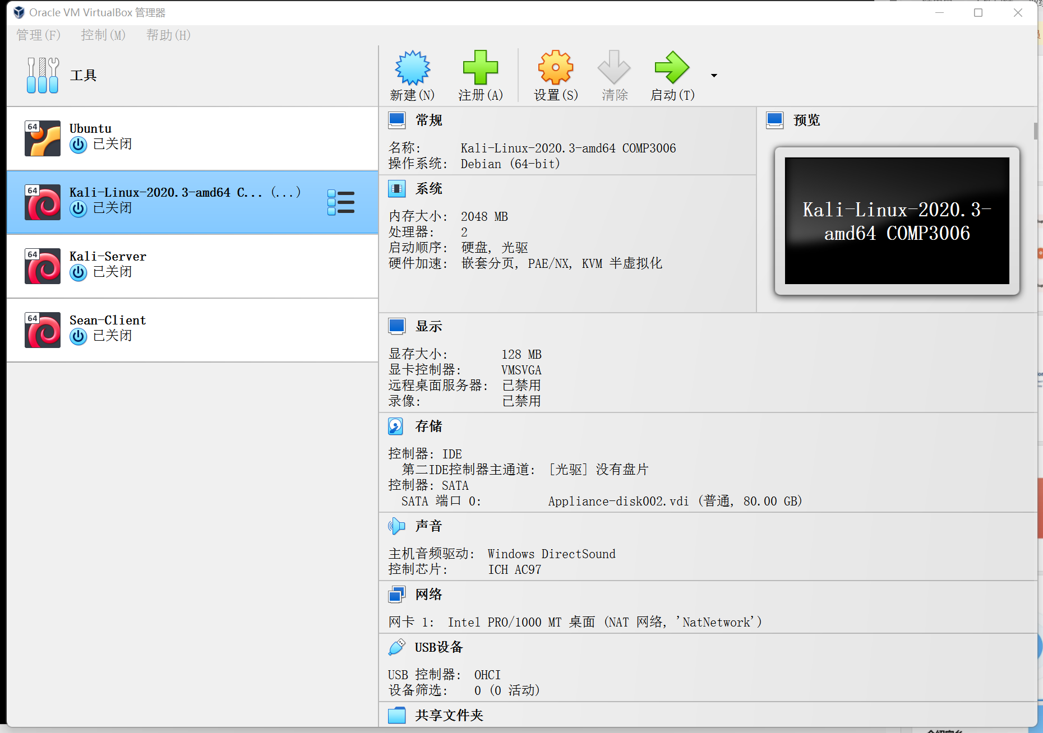
Now we have three machines
Client
Server
Client

Slide 4
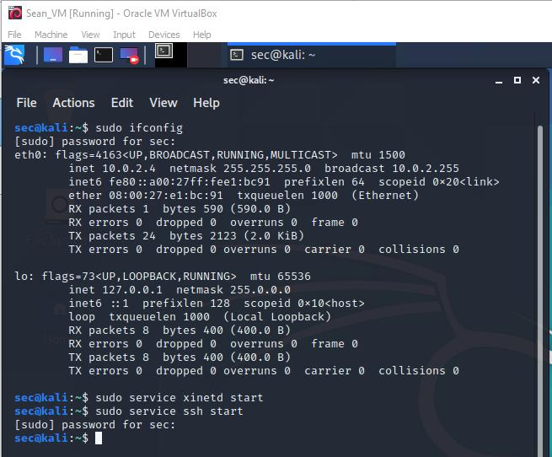
Kali-Server Machine
Type in
“sudo ifconfig”
Remember the IP address of your own server.
Then
Type in those two commands to set up the server.

Slide 5
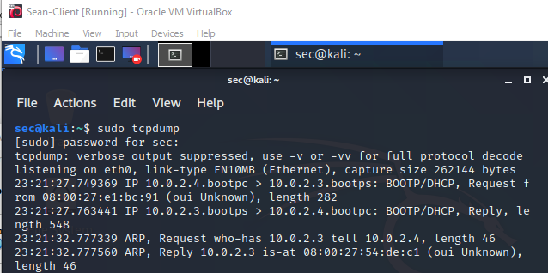
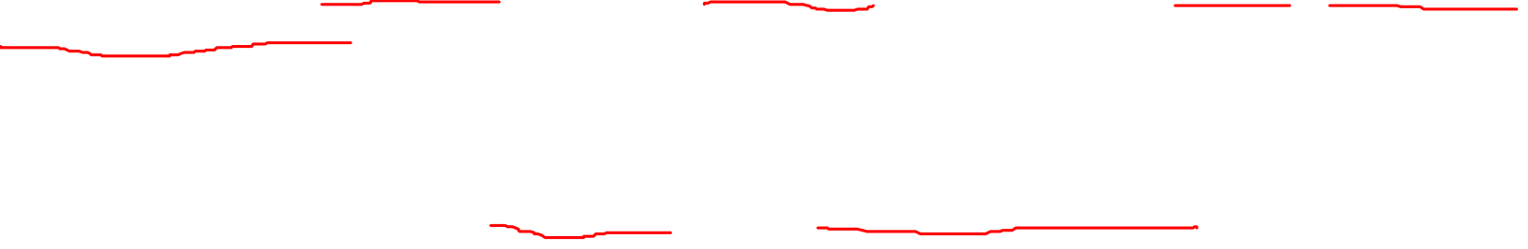
First, Open up two terminals on the client machine.
Type in “sudo tcpdump” to monitor infos.
Then, in the other window, send a few pings to the server, then cancel both using Ctrl+C.

Slide 6
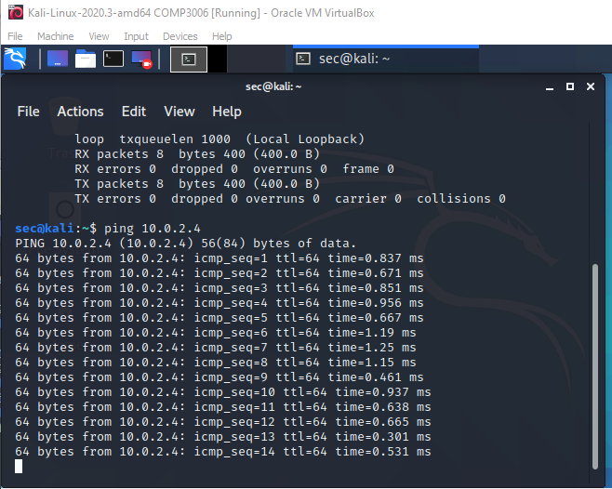
Client: Kali-Linux-2020.3
Ping the server

Slide 7
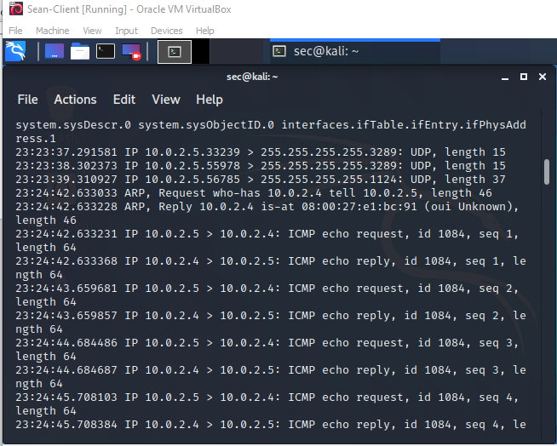

Output of
“sudo tcpdump”

Slide 8
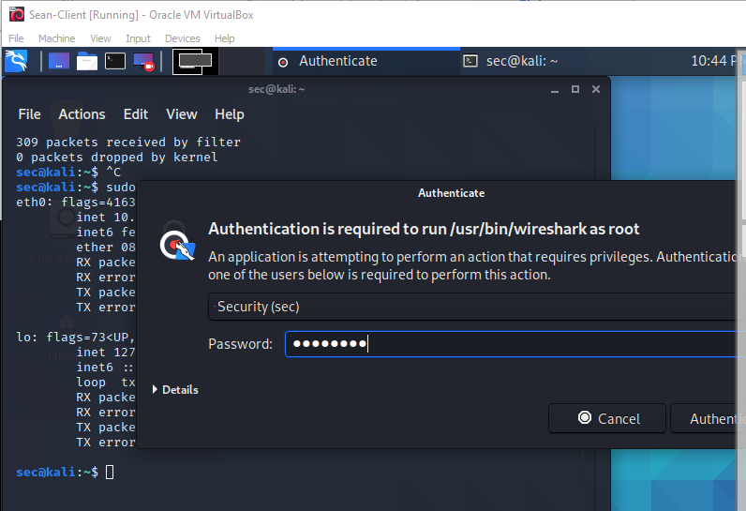
Click and search for “wireshark”
Psw: security

Slide 9
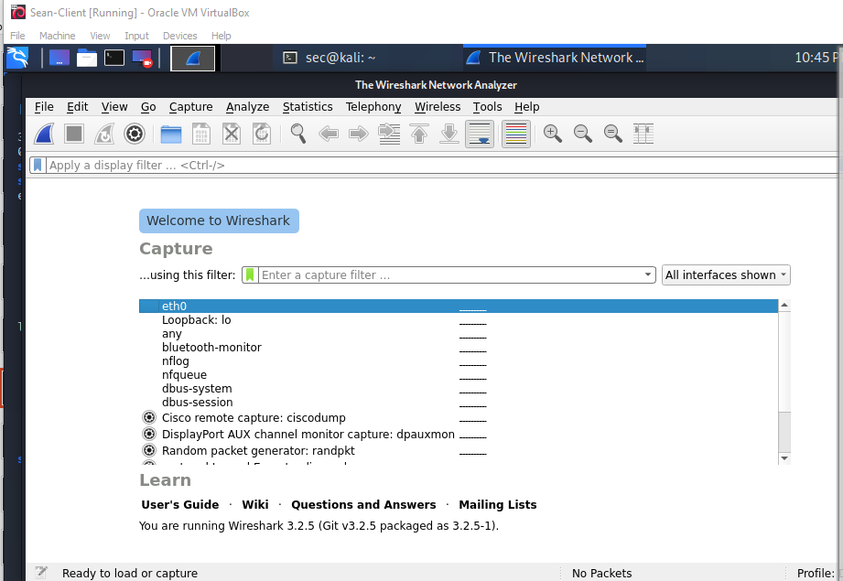
Double click

Slide 10
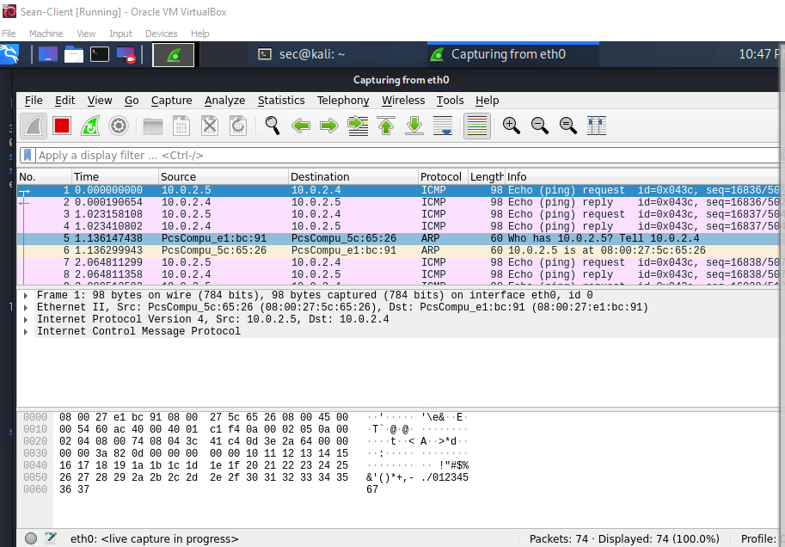


Slide 11
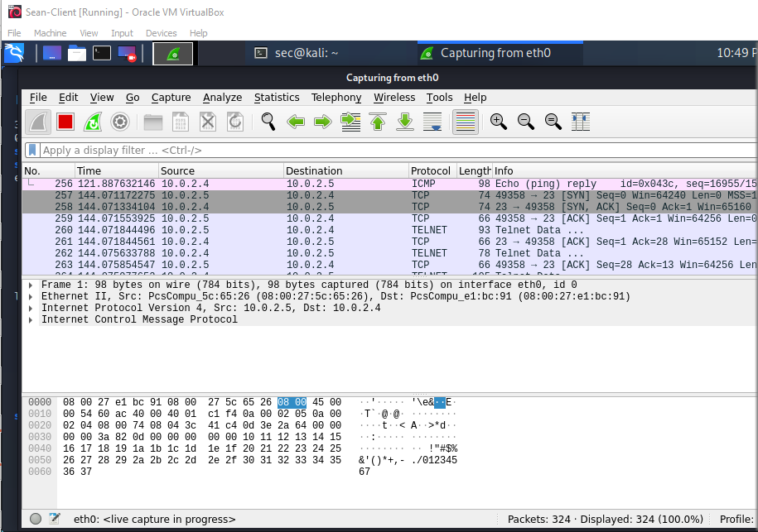

Use ctrl+C to stop the ping and type in “telnet xxxx”
xxxx is your server address

Slide 12
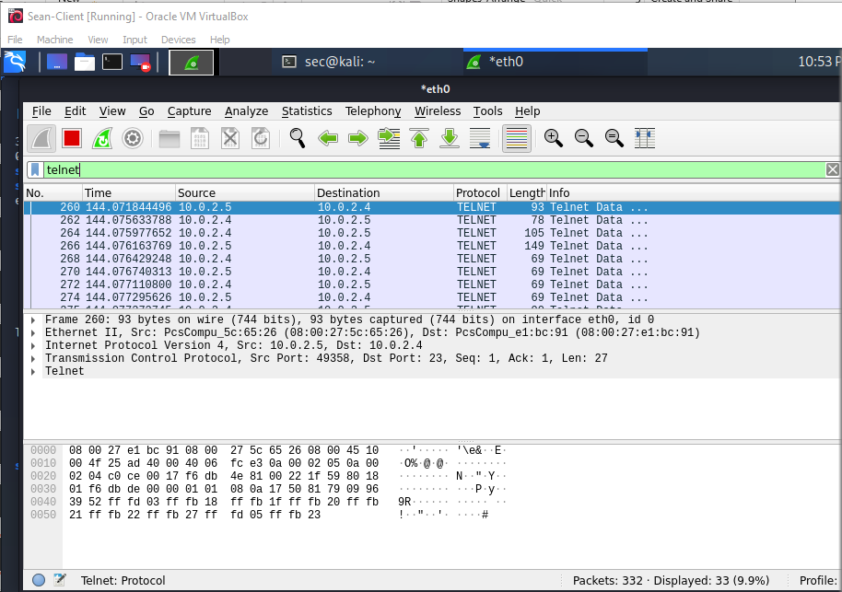

Slide 13
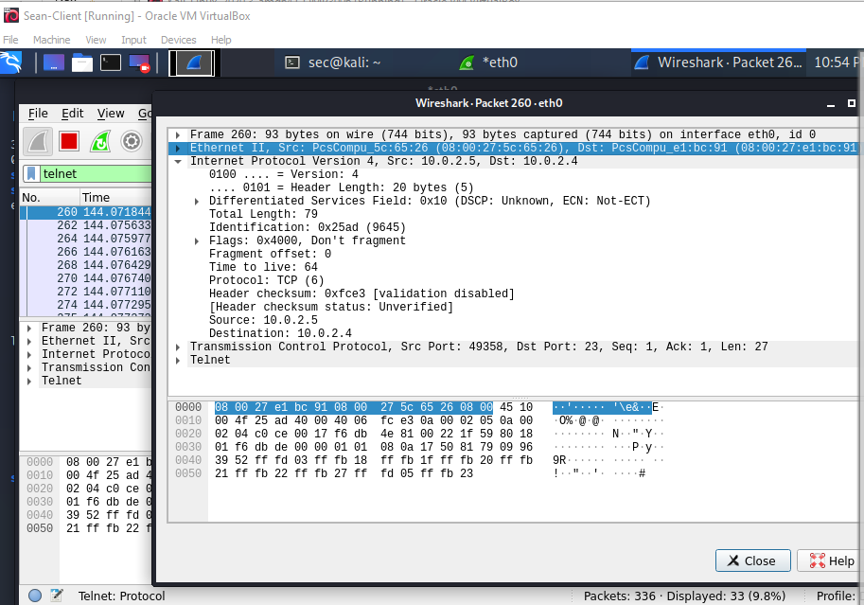

You can analyze the inner details of a single packet by double-clicking on it.

Slide 14
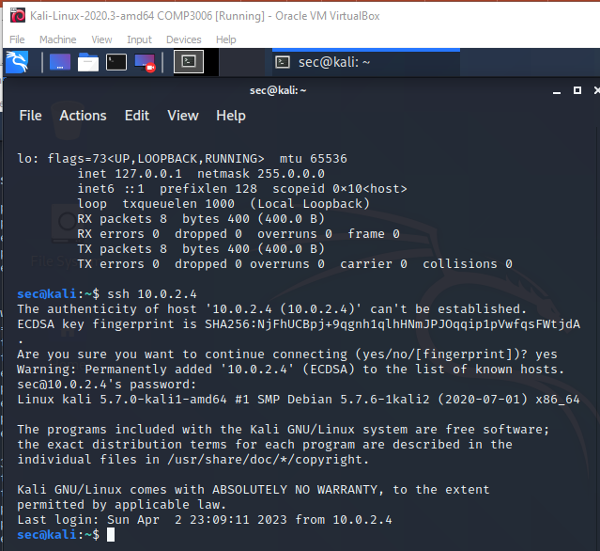
***Important
1. Start a new Wireshark capture
2. Open a new terminal and typed in “ssh xxxx”
xxxx is your server address.

Slide 15
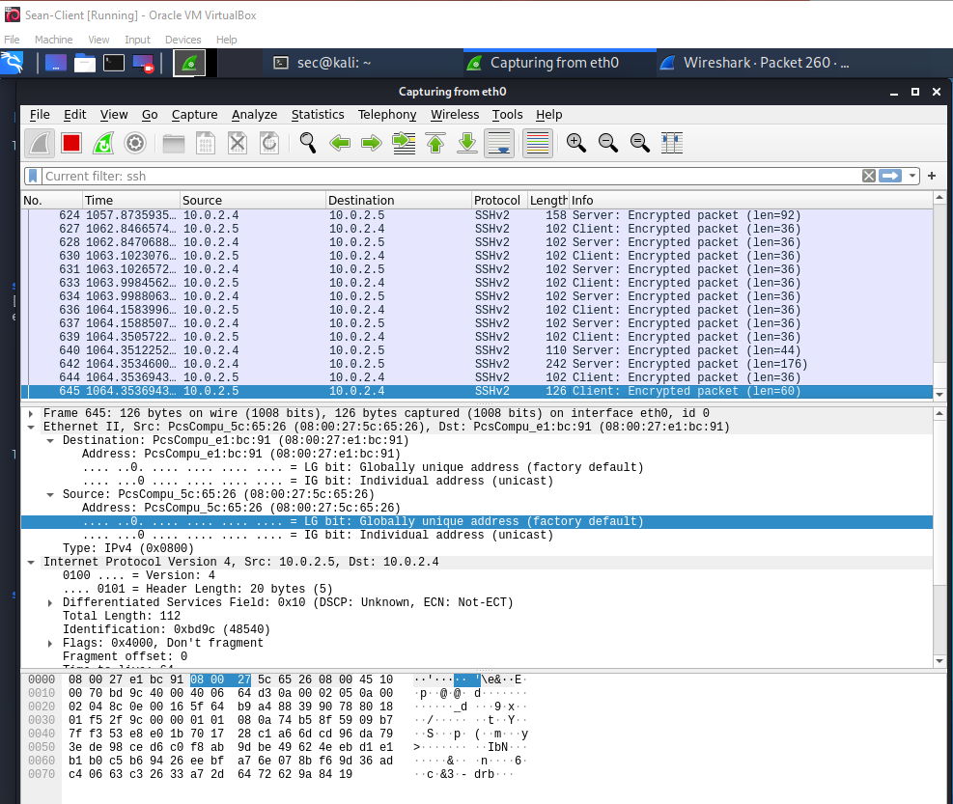

Slide 16
Please Remember to Shut Down the Virtual Machines

Slide 17
Additional Tasks:
Read the document COMP3052.SEC.LAB.04.Packet.Sniffing originally prepared by Mike Pound.
Work on the exercises described under the following sections from pages 2-5 for:
SETTING UP THE SERVER
PACKET CAPTURE
PACKET ANALYSIS

